Slide 1



DIVING INTO THE UNDERGROUND MARKET OF STEALER LOGS
Apurv Singh Gautam
ASG_Sc0rpi0n

Slide 2







ABOUT ME
Threat Researcher at Cyble
TA at StationX
Masters in Cybersecurity at Georgia Tech
Presented at conferences
Hobbies
Hiking
Lockpicking
Gaming/Streaming
Twitter: @ASG_Sc0rpi0n l Website: apurvsinghgautam.me
03 | www.cyble.com

Slide 3

AGENDA
Stealers: Introduction
Stealer Logs
Underground Market Analysis
Market beyond Stealer Logs
Protection for consumers/business
Conclusion
04 | www.cyble.com

Slide 4
Stealers: Introduction
05 | www.cyble.com

Slide 5




WHAT ARE STEALERS?
Trojan
Steal username, password, cookies, autofill, etc.
Used for initial access
06 | www.cyble.com
Notes:
Also known as info stealers
As basic as keylogger or more complex like getting username, autofills
Different types – Windows, Linux, Android
Different languages – C, C++, C#, Go, Rust

Slide 6

STEALERS OVER TIME
Zeus (2006)
Koobface (2008)
Currently most botnets have stealer capability
Examples: TrickBot, Emotet, LokiBot, etc.
07 | www.cyble.com
Notes:
Zeus – targeting banking credential
Koobface – targeting social media sites for credentials
Talk about change in stealers from 2006 till today

Slide 7

CURRENT MARKET OF STEALERS
Top Stealers
2016
Agent Tesla*
Formbook*
RedLine*
Raccoon*
Mars
Vidar*
Oski
Bloody
AZORult
Loki
CopperStealer
KPOT
AZORult
2018
Vidar
2019
Raccoon
2020
RedLine
* Widely known stealers
08 | www.cyble.com
Notes:
Stealers has been around for over 5 years now
Many others – Blackguard, Jester Stealer

Slide 8




INFECTION METHODS
Leverage anti-evasion techniques
Phishing, torrents, pirated software, compromised websites, etc.
Rely on Wrappers/Packers/Cryptors
09 | www.cyble.com
Notes:
Like many viruses and trojans -> Phishing, exploit kits, infected websites, youtube channels
Infecting normal users as well as orgs
Malicious attachments sent by spam campaigns, websites infected by exploit kits, malvertising…
Anti VM/Anti Sandbox
bypass security controls & protect from detection
explicit intent of stealing credentials and performing data exfiltration

Slide 9
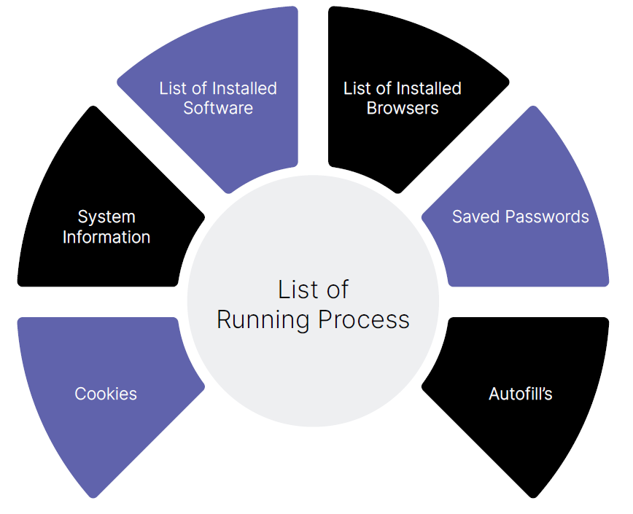
CAPABILITY OF STEALERS
Keylogging
Hooking into browsers and other applications
Utilizing Web Injection scripts
10 | www.cyble.com
Notes:
Steal info from - browsers, password managers, FTP Clients, Crypto-Wallets, VPN Clients, Email clients, etc.
Gaming clients – Steam, Uplay, Minecraft
Messaging clients – Discord, Telegram, Element
Adding form fields in browser and intercepting field values

Slide 10
Stealer Logs
11 | www.cyble.com

Slide 11

TYPES OF LOGS GENERATED
Browser Cookies
Browser Autofills
Crypto Wallets
Steam/Discord Tokens
Login Details
Payment Details
12 | www.cyble.com
Notes:
Login Details – contains username, password list taken from browsers
Payment Details – grabbing credit card info or banking info taken from banking sites

Slide 12

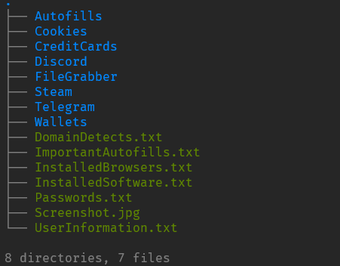
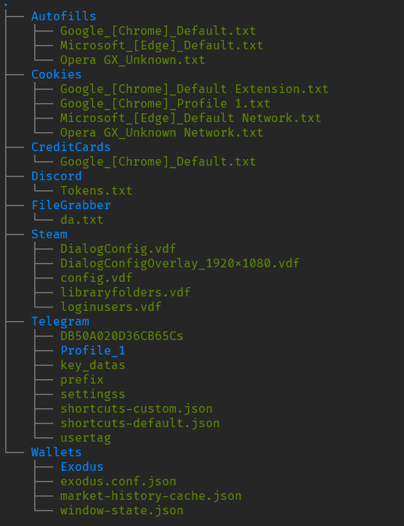
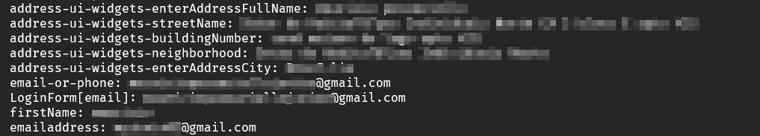
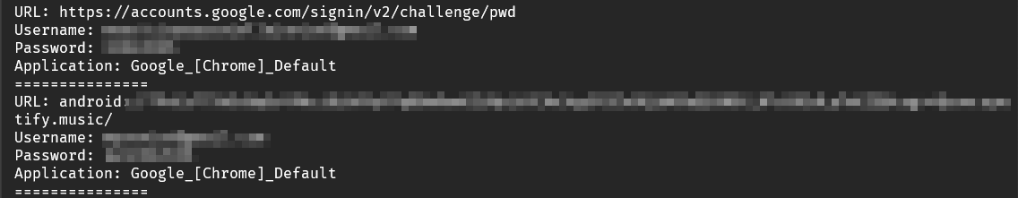
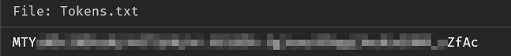

EXAMPLE OF STEALER LOGS
13 | www.cyble.com

Slide 13
Underground Market Analysis
14 | www.cyble.com

Slide 14
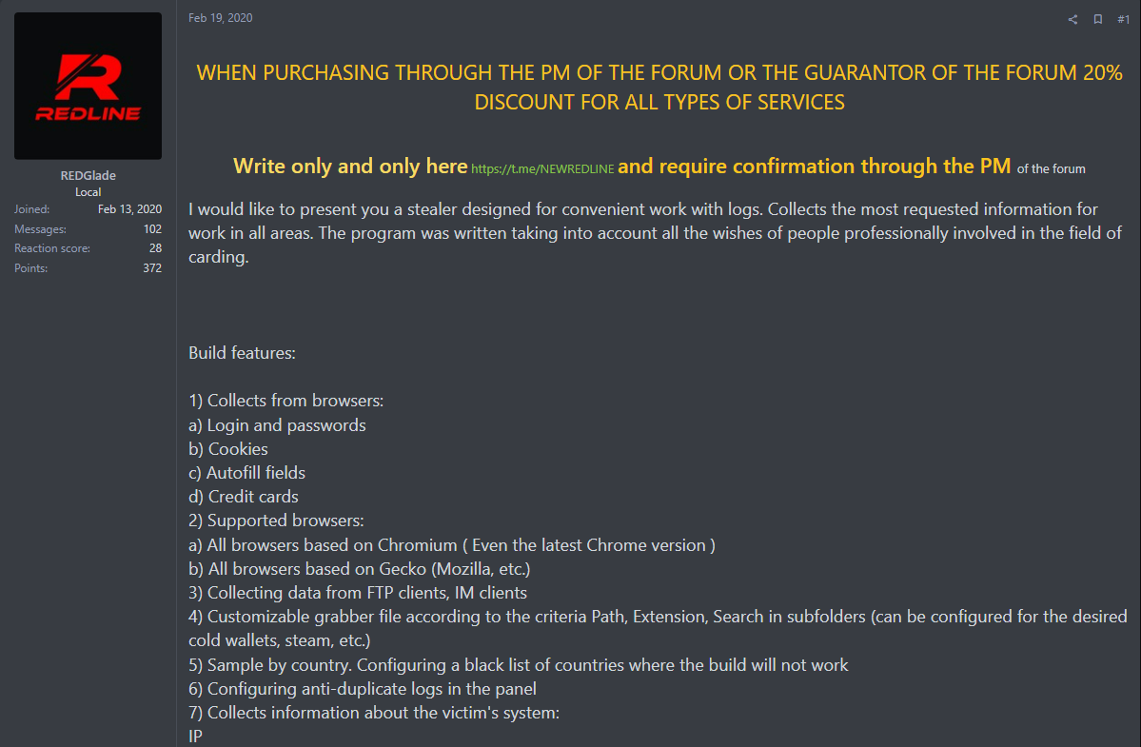
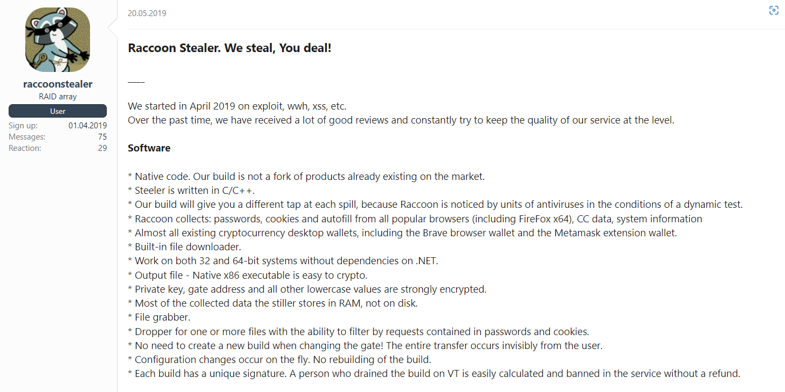
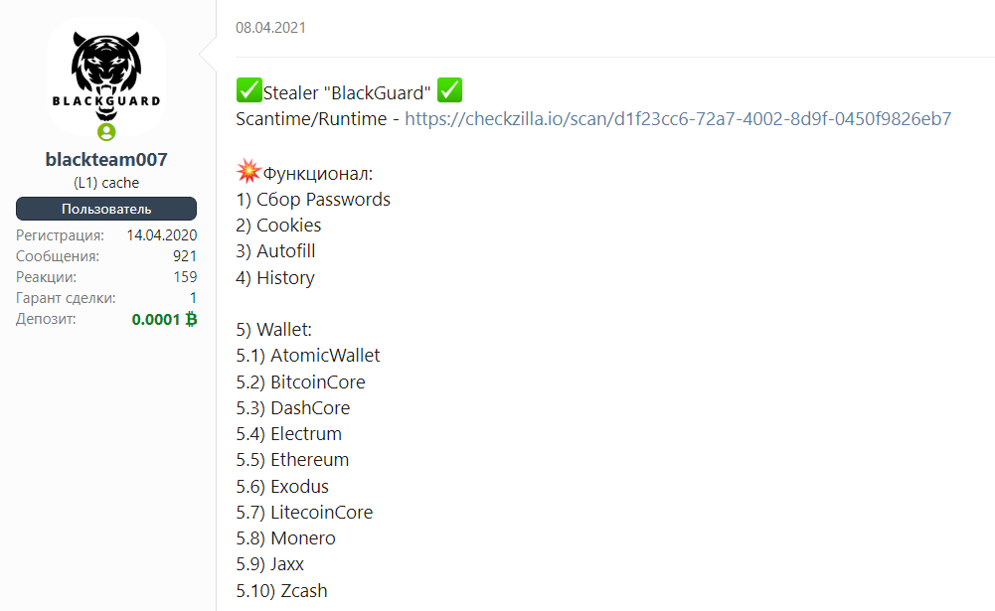
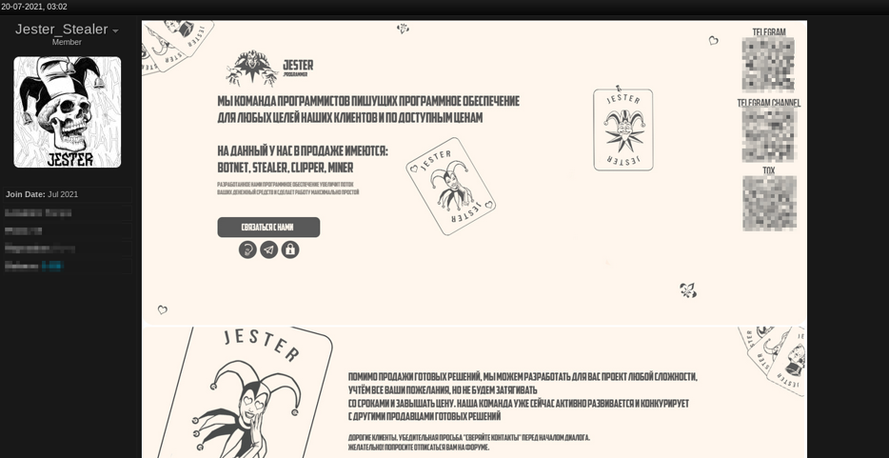
STEALERS LANDSCAPE
15 | www.cyble.com
Notes:
Malware as a Service model
Forums like XSS, Exploit

Slide 15
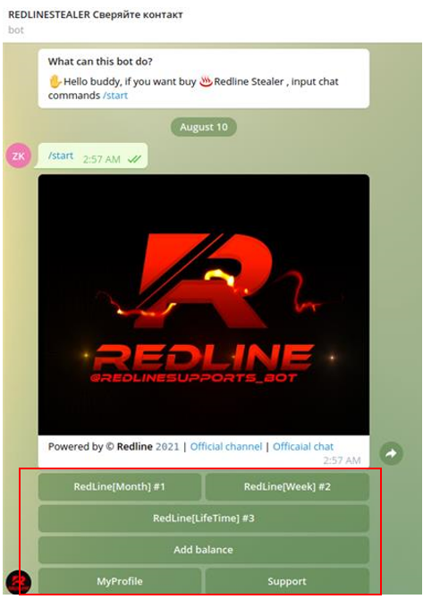
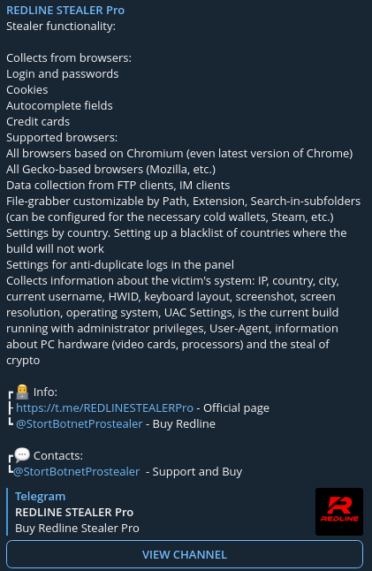
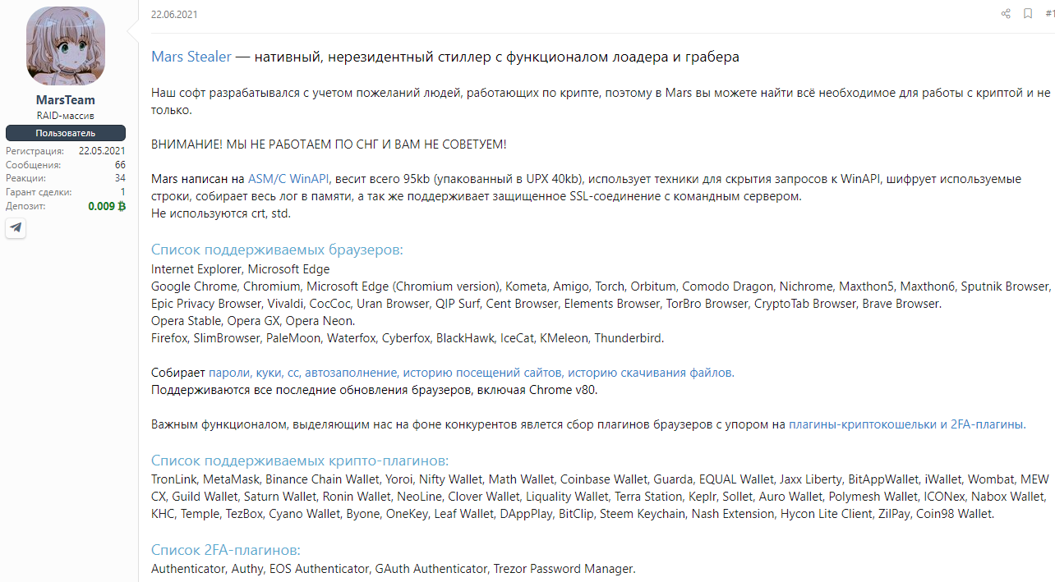
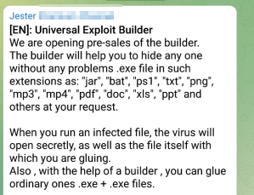
STEALERS LANDSCAPE (Contd.)
16 | www.cyble.com
Notes:
Stealers shifting to Telegram for “as a service”
Price - $50/month to $300/month
Lifetime - $300 to $1000
Written in C/C++/C#

Slide 16
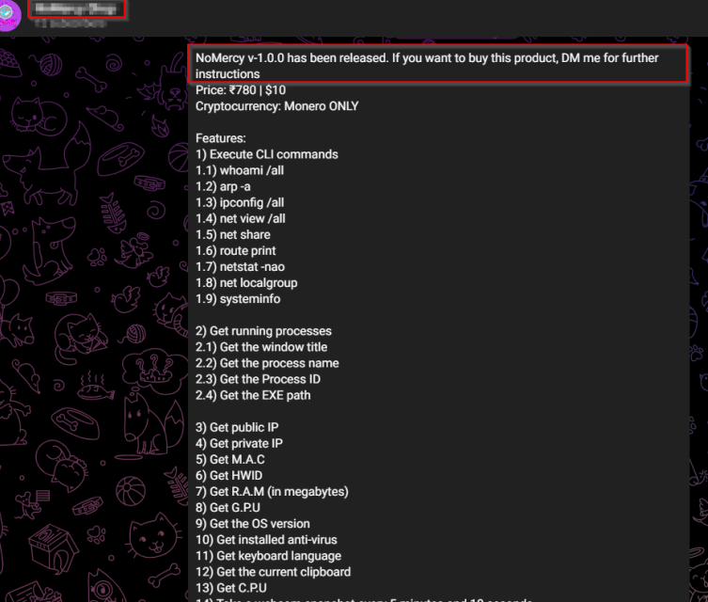
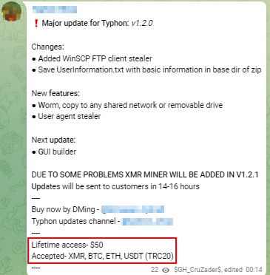
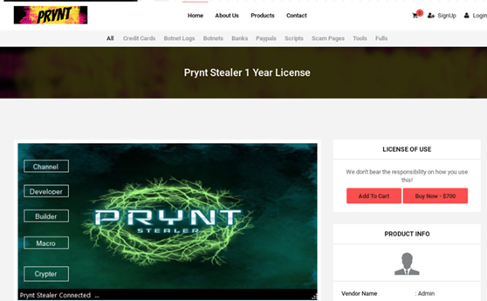
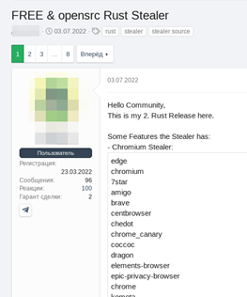
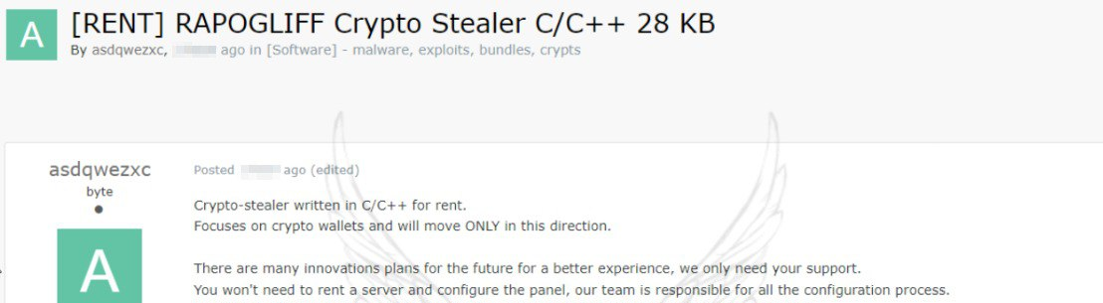
NEW/PRIVATE STEALERS ON THE MARKET
17 | www.cyble.com
Notes:
NoMercy, Loli Stealer, Prynt stealer, Typhon stealer, Lightning stealer
Luca stealer, Pennywise
Written in Go/Rust
Price range - $10 to $700

Slide 17
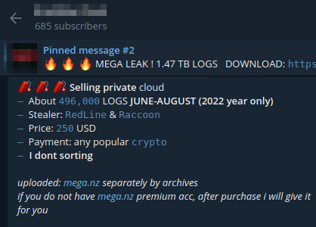
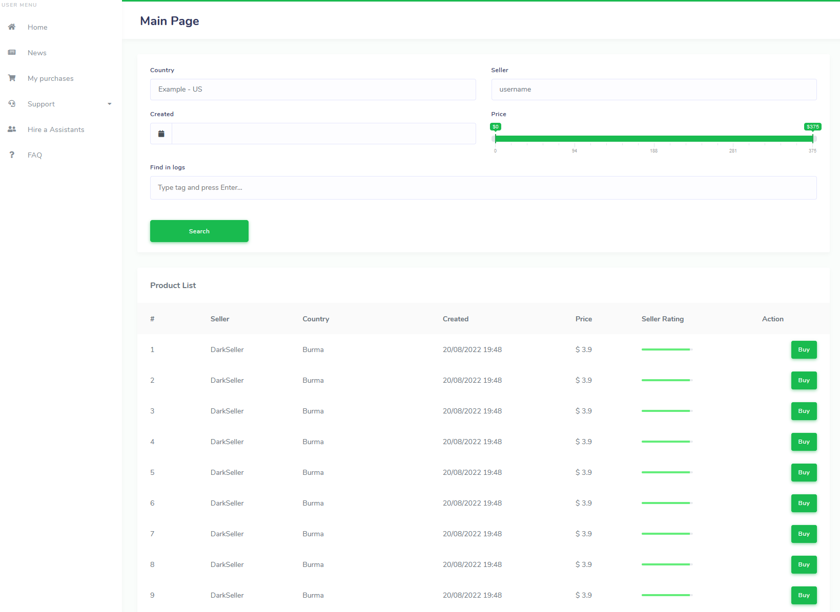
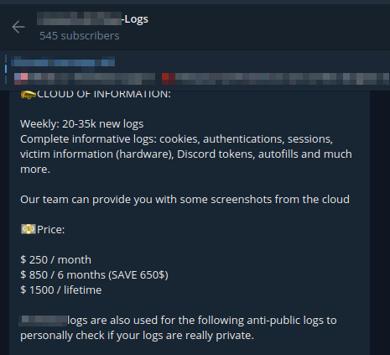
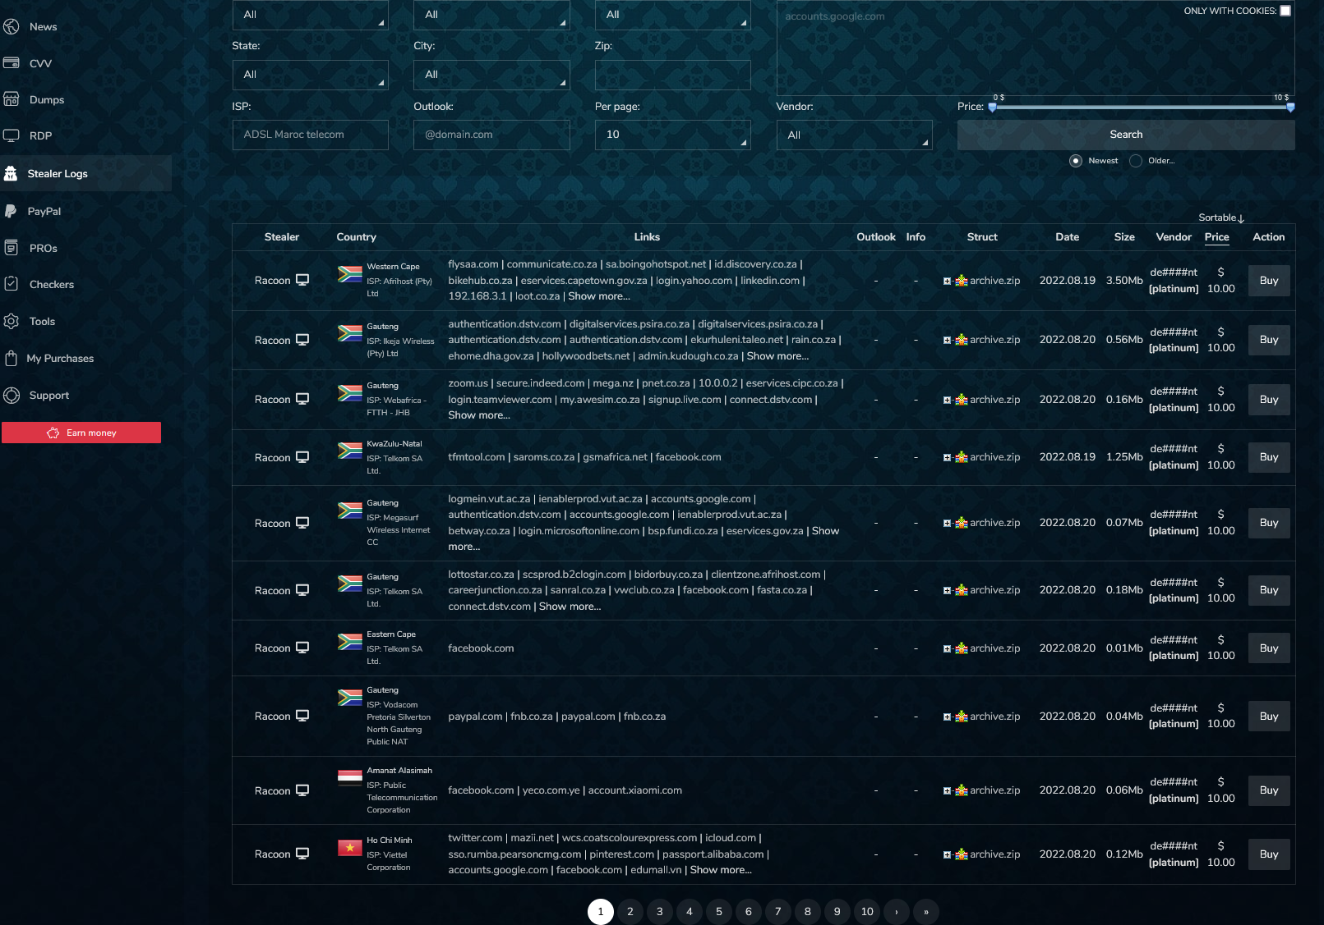
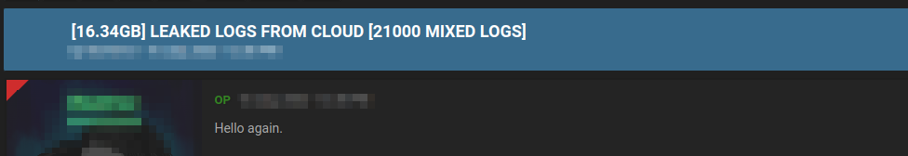
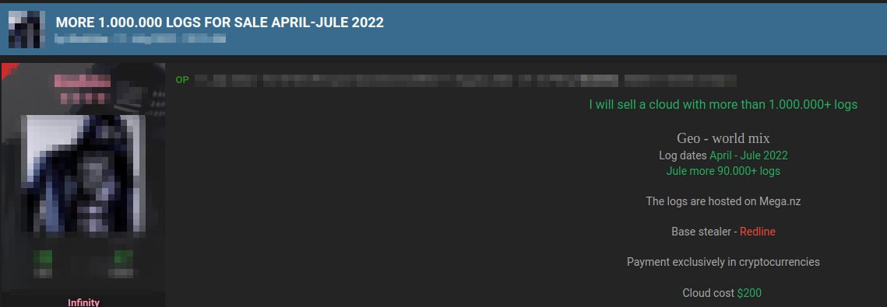
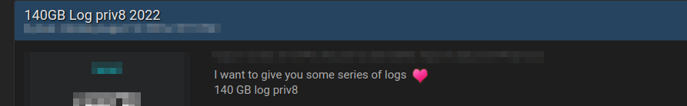
STEALER LOGS LANDSCAPE
18 | www.cyble.com
Notes:
Forums like Breached, Cracked, XSS, Exploit, etc
Telegram channels
2easy, russianmarket

Slide 18
Market Beyond Stealer Logs
19 | www.cyble.com

Slide 19
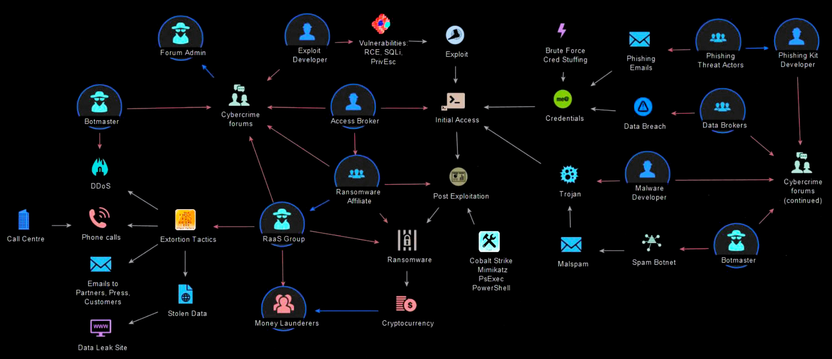

HOW ARE STEALER LOGS USED?
Source: Will (@BushidoToken)
20 | www.cyble.com
Notes:
IABs using several techniques to gain access to systems, installing stealers, and exfiltrating logs
Selling it on forums – used by APT groups, ransomware affiliates, other threat actor groups

Slide 20
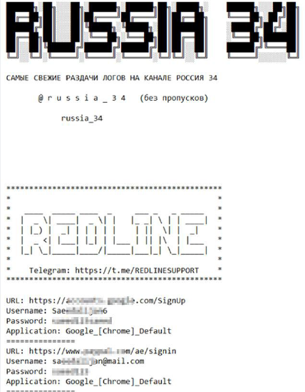
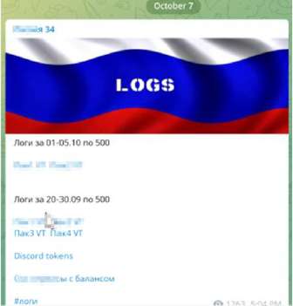
HOW ARE STEALER LOGS USED? (Contd.)
Threat Actor Group | Stealer Used
APT 28 | CredoMap
APT Group (TA505) | Raccoon
Operation Epic Manchego, FIN 11 | AZORult
Pinchy Spider, FIN 11 | Vidar
APT 29 | CryptBot
Conti | Raccoon, RedLine, CryptBot
Hive | RedLine
Lapsus$ | RedLine
21 | www.cyble.com
Notes:
Lapsus extortion group heavily utilizing info stealers. Behind attacks like Nvidia, Samsung, Vodafone, Okta, Microsoft

Slide 21

IMPACT
Gaining initial access to organizations
Espionage, Data Theft, Extortion
Ransomware
22 | www.cyble.com

Slide 22
Protection for consumers/business
23 | www.cyble.com

Slide 23

PROTECTION FOR ORGS
Block URLs that could be used to spread the malware, e.g., Torrent/Warez.
Monitor any unusual endpoint behavior and network beacons to block data exfiltration by malware.
Use the IOCs which are present on public platforms to monitor and block malware infection.
Educate employees in terms of protecting themselves from threats like phishing’s/untrusted URLs.
24 | www.cyble.com
Notes:
Latest AV, prevention and detection software
Awareness about infection methods
Network segmentation
Email security controls

Slide 24

PROTECTION FOR USERS
Avoid downloading pirated software from warez/torrent websites.
The “Hack Tool” present on sites such as YouTube, torrent sites, etc., mainly contain such malware.
Use strong passwords and enforce multi-factor authentication wherever possible.
Refrain from opening untrusted links and email attachments without first verifying their authenticity.
25 | www.cyble.com
Notes:
2FA/MFA
Automatic software update

Slide 25
Conclusion
26 | www.cyble.com

Slide 26

WHAT WE DISCUSSED SO FAR?
Stealers and their capabilities
Structure of stealer logs
Underground landscape for stealers
Market of stealer logs
Usage of stealer logs by TAs
Protection for users/orgs
27 | www.cyble.com

Slide 27
RESOURCES
Cyble - Analysis of Stealer Malware Family
Cyble – Stealer Blogs
US CISA Alert (AA22-216A) – 2021 Top Malware Strains
Microsoft – DEV-0537 (LAPSUS$) Blog
Kaspersky – Common TTPs of the modern Ransomware Report
28 | www.cyble.com

Slide 28




THANK YOU
Any questions?
Website
apurvsinghgautam.me
@ASG_Sc0rpi0n
/apurvsinghgautam

